Slide 1

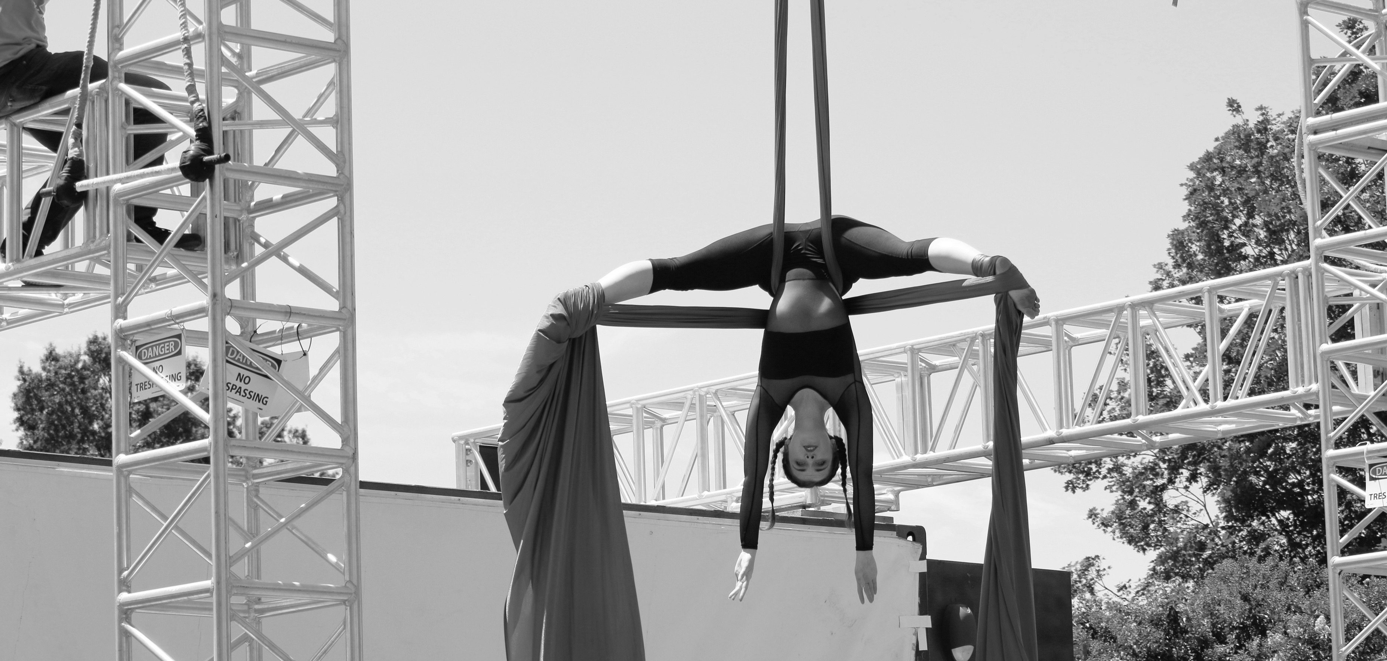
Notes:
Prepared for the presentations to CEEC freshman seminar classes (Ryan Mulkeen), 9-27-17

Slide 2
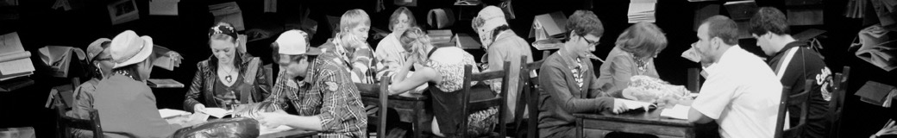

Revising SLOs During Curricular Redesign
Dr. Lynne Conner
Chair, Department of Theatre
Elena Payne-Wiens
Assistant Dean for Advising & Assessment
Assessment Academy
March 26, 2018

Slide 3
Why we do what we do
The Cross-Trained Artist
(video, 4:21)

Slide 4
History
Elena
Theatre SLOs, 2011-2015
Lynne
New Chair, Fall 2016
Together with Faculty
Redesigning SLOs, Spring 2017

Slide 5
Process
Document for All: SLO and Assessment Best Practices for Theatre
Meet, Discuss, Meet, Decide, Publish new/revised SLOs
Assessment Grant: Course Packets for Performance and Design/Tech areas

Slide 6
New Approach
Course Packets & Rubrics
Scenic Design Project & Rubric
Acting I Course Packet
Benefits: organic, emerged from faculty,
make sense to faculty and students
Challenges: administration, communication, consistency

Slide 7
New Curriculum
Curricular Revision for Fall 2018
  BA in Theatre, new & revised Concentrations
    Performance
    Design/Tech
    Dramaturgy, Directing & Dramatic Writing
    Applied Theatre
    Theatre Education
  Minor in Theatre

Slide 8
The Future
Accreditation: National Association of Schools of Theatre (NAST)
Capstone Courses & Projects
New Ways of Working
Alignment & Scaffolding
Transferrable Skills & Vocabularies

Slide 9
Discussion
What are your experiences?
Thoughts? Questions? Ideas?
Take-aways?
Thank you!

Slide 10

Events & Tix: arts.uncc.edu
Notes:
Prepared for the presentations to CEEC freshman seminar classes (Ryan Mulkeen), 9-27-17

