Slide 1

Faculty Briefing:
Program and Off-campus Instructional Site Changes
Navigating SACSCOC, U.S. Department of Education, and UNC System Requirements Successfully

Slide 2
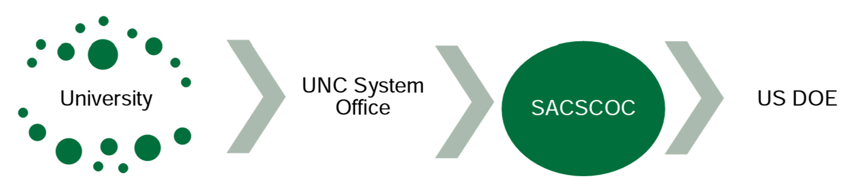
Review and Approval Processes
Substantive Change Review 2

Slide 3
Review and Approval:
University and UNC System
New degree program procedures
Request for Preliminary Authorization (formerly “Letter of Intent”)
  Department(s) proposes program to appropriate Dean.
  Dean consults with the Provost and seeks authorization to proceed with Request for Preliminary Authorization.
  Dean consults with the Assistant Provost to schedule a 90-minute Kick-Off Meeting.
  Department(s)/program(s) drafts and uploads a New Degree Program - Part One: Request for Preliminary Authorization form to Curriculog. These addendums should also be included:
    Substantive Change Planning Questionnaire and
    UNC System Academic Program Planning Financial Worksheet.
Substantive Change Review 3

Slide 4
Review and Approval:
University and UNC System
New degree program procedures
Request for Preliminary Authorization (formerly “Letter of Intent”)
  Note: If the proposed program includes online and/or off-campus delivery, Program Form 4: Program Delivery should also be completed within Curriculog.
  Within Curriculog, the Request for Preliminary Authorization is routed to: Department Chair(s), Dean(s), Office of Assessment, Dean of the Graduate School (if applicable), and the Graduate Council or Undergraduate Course and Curriculum Committee, as appropriate.
  Following review by the Graduate Council/Undergraduate Course and Curriculum Committee, the proposal is routed via Curriculog to the Faculty President for notification and to the Provost and Office of Academic Affairs for review.
Substantive Change Review 4

Slide 5
Review and Approval:
University and UNC System (cont.)
New degree program procedures
Request to Establish
  Draft and upload the Request to Establish form
  Complete Student Learning Outcomes Assessment Plan
  If needed, update the UNC System Academic Program Planning Financial Worksheet
  If SACSCOC Prospectus is required (see Substantive Change Planning Questionnaire step in Part I: Request for Preliminary Authorization procedure), submit Faculty Roster form as part of Request to Establish.
  Within Curriculog, the Request to Establish is routed through the faculty governance review process with notification to the Assistant Provost.
  Following Faculty Council approval, the proposal is routed via Curriculog to the Provost and Office of Academic Affairs for review.
Substantive Change Review 5

Slide 6
Review and Approval:
University and UNC System (cont.)
Other program procedures
Adding a new method of delivery to an existing program – Request to Deliver
  Complete Curriculog Program Form 4: Program Delivery (for changing how or where a program is delivered)
Adding online, site-based, or off-campus delivery to an existing degree program
  Department(s) prepares the Request to Deliver and the Academic Program Planning Financial Worksheet and submits via Curriculog using the Program Delivery Form.
Closing a program, site, and/or delivery method –Request to Discontinue
  Complete Curriculog Program Form 1: Program Revision or Inactivation
Substantive Change Review 6

Slide 7
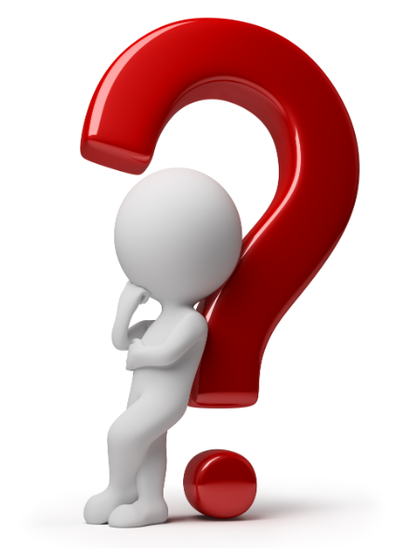
Question:
Why is SACSCOC interested in changes occurring at an already accredited institution?
Changes must align with the institutional mission
Changes must have sufficient resources
Educational practices must be sound
Substantive Change Review 7

Slide 8
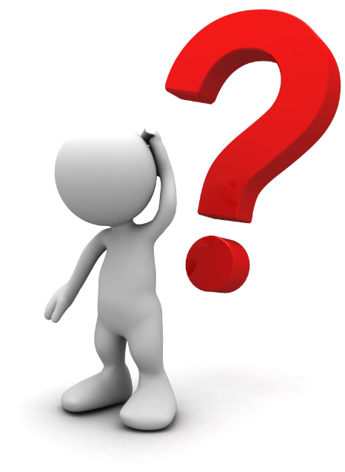
Question:
What is a substantive change?
The addition of courses or programs that represent a significant departure, either in content and expertise or method of delivery, from those that were offered when the institution was last evaluated.
Substantive Change Review 8

Slide 9
Question:
What is a substantive change?
Major change examples (SACSCOC approval required)
New degree or certificate program with 50% or more new course content
New off-site with 50% or more of program credits
Increasing or decreasing the program’s number of credit hours by 25% or more AND students' expected time to completion increases or decreases by more than one term or its equivalent or comparable measure.
Dual or joint degree (non-SACSCOC partner)
Closing a program, site, or program at a site
Substantive Change Review 9

Slide 10
Question:
What is a substantive change?
Minor change examples (SACSCOC notification required)
New degree or certificate program using existing course content or 25-49% new content
New off-site location delivering 25-49% of program credit hours
Adding a method of instructional delivery to an existing program when 50% or more of the program is delivered by more than one method:
  competency-based education,
  distance education, and
  face-to-face instruction.
Substantive Change Review 10

Slide 11
Review and Approval:
SACSCOC
Major changes require submission to SACSCOC and approval of a written prospectus
Helpful Resources:
  Crosswalks from Request for Preliminary Authorization and Request to Establish to SACSCOC Prospectus
  Prospectus guide and examples
  Substantive Change Planning Questionnaire
  Substantive Change Checklist
  Substantive Change PowerPoint Presentation
  Submission process is facilitated and documented via workflow in Curriculog
Substantive Change Review 11

Slide 12
Review and Approval:
Department of Education
U.S. Department of Education (USDOE) approval follows SACSCOC approval/notification
  Submission process is facilitated and documented via workflow in Curriculog
  Office of Financial Aid will provide notification to USDOE for:
    A stand-alone certificate program that is one academic year and leads to gainful employment
    An off-campus site that offers 50% or more of a degree program
  Office of Financial Aid will document approval
Substantive Change Review 12

Slide 13
How long will it take?
 | Campus and UNC System Approval | SACSCOC Prior Approval | USDOE Approval | Total Time
New degree or certificate program (50% or more new content) | 1 to 2+ years | 6 to 11 months | 3 to 4 months | 2 to 3+ years
New off-site location offering 50% or more of total program credit hours | 1 year | 6 to 11 months | 3 to 4 months | 1 to 2+ years
Dual or joint degree | 1 to 2 years | 6 months | 3 to 4 months | 2 to 3+ years
Increasing/decreasing the number of credit hours and expected time to completion | 2 to 6 months | 6 months | 3 to 4 months | 1+ year
Substantive Change Review 13

Slide 14
How long will it take?
 | Campus and UNC System Approval | SACSCOC Prior Approval | USDOE Approval | Total Time
Closing a degree or certificate program | 2 to 6 months | 6 months | 3 to 4 months | 1 to 2 years
New degree or certificate program (25-49% new credit hours) | 1 to 2+ years | N/A Notification Only | 3 to 4 months | 2+ years
New off-site location offering 25% to 49% of total program credit hours | 2 to 6 months | N/A Notification Only | N/A | <1 year
Adding a method of instructional delivery to an existing program | 2 to 6 months | N/A Notification Only | 3 to 4 months | <1 year
Substantive Change Review 14

Slide 15
Review and Approval:
Other Timing Considerations
The timeline begins when the Request for Preliminary Authorization is submitted to the System Office and does not take into account other factors such as:
  The Provost and Chancellor need to approve the program to go forward
  The need for availability in our queue at the UNC System Office
  Course development/approval
  The time it takes the unit to discuss, plan, draft, and revise the proposal
  The time it takes the Dean, Provost, and Chancellor to review and comment on the proposal
  Academic year and summer break implications for faculty governance and Board of Governors review
  Type of SACSCOC Review and deadlines (Full Board of Trustees vs. Executive Council
  of the Board of Trustees)
Substantive Change Review 15

Slide 16
Review and Approval:
Other Timing Considerations (cont.)
Distance Education
Course/program modality
  DE will create an online course development schedule based on internal capacity
  All off-site activities must be approved by the UNC System Office
  Off-site locations must be reviewed and approved by DE
Recruitment and Enrollment
Advertising and marketing
Recruitment
Application processes
Enrollment
Substantive Change Review 16

Slide 17
Website Resources
Office of Assessment and Accreditation
  https://assessment.charlotte.edu
  https://assessment.charlotte.edu/accreditation/sacscoc/substantive-change
Request for Preliminary Authorization
https://provost.charlotte.edu/policies-procedures/academic-policies-and-procedures/new-degree-programs-part-i
Request to Establish
  https://provost.charlotte.edu/policies-procedures/academic-policies-and-procedures/new-degree-programs-part-ii-request-establish
Academic Program Planning and Authorization
  https://provost.charlotte.edu/curriculum-catalogs/academic-program-planning-and-authorization
Curriculog
  https://charlotte.curriculog.com/
Substantive Change Review 17

Slide 18
Personnel Resources
Christine Robinson
Assistant Provost for Institutional Effectiveness and Analytics
SACSCOC Accreditation Liaison for UNC Charlotte
CRobinson@charlotte.edu
Steve Carter
Leslie R. Zenk
Associate Director, Strategy Implementation & Reporting
Resource for Distance Education program approval and operation, including online and off-site instruction
SCarte79@charlotte.edu
Assistant Provost and Campus Program Coordinator for UNC Charlotte and UNC System Office
LZenk@charlotte.edu
Johnna Watson
Shanna Coles
Associate Dean, Graduate School
Resource for graduate programs
JWWatson@charlotte.edu
Associate Director, Program Development & Learner Solutions
School of Professional Studies
ShannaColes@charlotte.edu
Substantive Change Review 18

Slide 19

Questions?
Think years, not months.
We look forward to working with you.
Substantive Change Review 19

